Slide 1


Slide 2

Don’t get Phished!
Peter Schmidt (MVP, MCM)
@petsch

Slide 3


About me...
Peter Schmidt
Freelance Cloud Architect
NeoConsulting
Microsoft MVP: Office Apps & Services (11 years)
Founder: CoLabora User Group Denmark
MCM & MCSM: Exchange
Contact Me
Twitter: @petsch
Blog: https://www.msdigest.net/
Mail: peter@neoconsulting.dk
Phone: +45 2080 9436

Slide 4
Agenda
Intro
Spoofing & Phishing
SPF / DKIM / DMARC
Office 365
DEMO
Summary

Slide 5
What Are We Talking About?
Phish
Spoofing
SPF
Sender Policy Framework
DKIM
DomainKeys Identified Mail
DMARC
Domain Message Authentication Reporting & Conformance
The fraudulent attempt to obtain sensitive information
A way to prove the sender really is the sender
Creation of email messages with a forged sender address
Impersonation
Common technique in targeted phishing attacks
Authentication

Slide 6
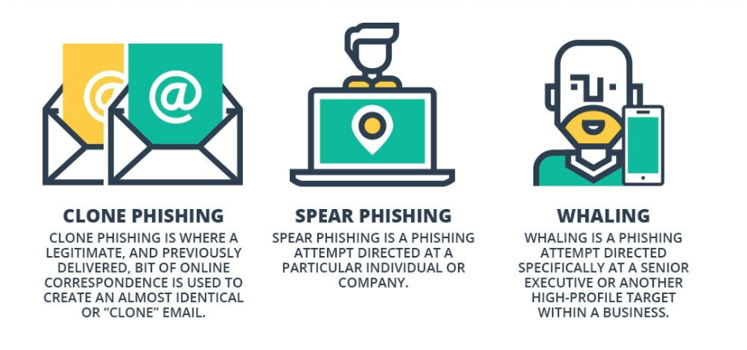
Types of Phishing

Slide 7
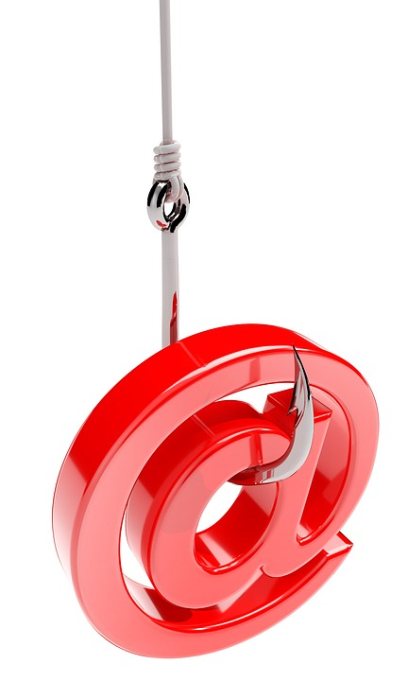
Phishing Insights
Most common disguises:
Bill / invoice (15.9%)
Email delivery failure (15.3%)
Legal / law enforcement (13.2%)
Scanned document (11.5%)
Package delivery (3.9%)
The most common malicious attachment types:
Office
Archive
PDF
92.4% of malware is delivered via email
Phishing has grown 65% in the last year
Source: Cisco CyberSecurity Report 2018

Slide 8
What is the issue ?
SMTP has always, by default, been anonymous
You can easily send an email pretending it came from someone else
“Proper” use of this include outsourced marketing and mailing lists
Its difficult to implement this well and the perceived complexity means that companies worry their email will get blocked if they implement it badly

Slide 9
DMARC Policies of Fortune 500 Companies
Source: Agari - March 2018

Slide 10
How Do We Authenticate Emails We Receive
SPF
v=spf1 ip4:1.2.5.5 ip4:8.2.7.4 ip4:7.3.2.2 ip4:5.5.1.8 include:_spf.salesforce.com include:spf.protection.outlook.com -all
DKIM
"v=DKIM1; p=MIGfMA0GDQEBgQCrZ6z … 6UvqP3QIDAQAB"
DMARC
v=DMARC1; p=reject; rua=mailto:dmarc@dmarc-aggregator.com; ruf=mailto:dmarc-ruf@dmarc-aggregator.com
To send email to Microsoft (i.e. to an Office 365 user or Outlook.com) then you need to implement this to stop your email being marked as spam

Slide 11
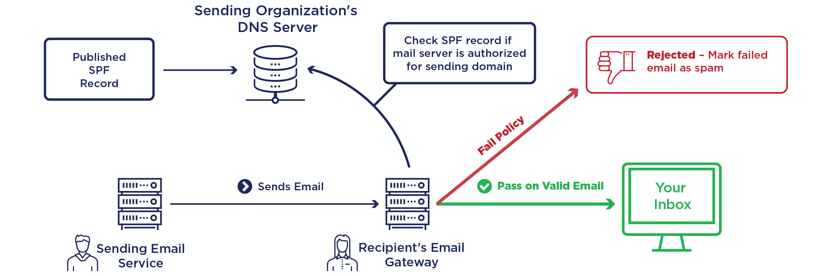
Sender Policy Framework (SPF)

Slide 12
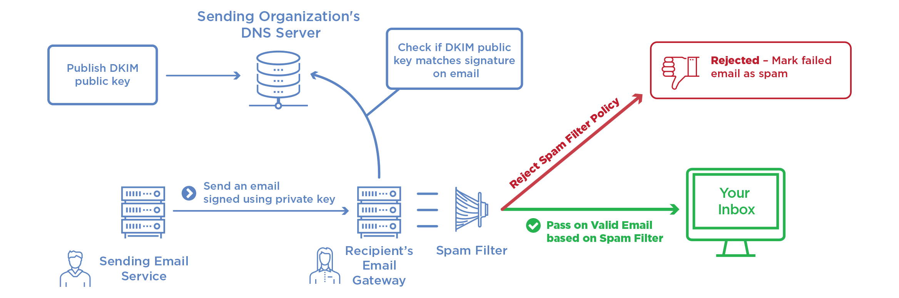
DKIM

Slide 13
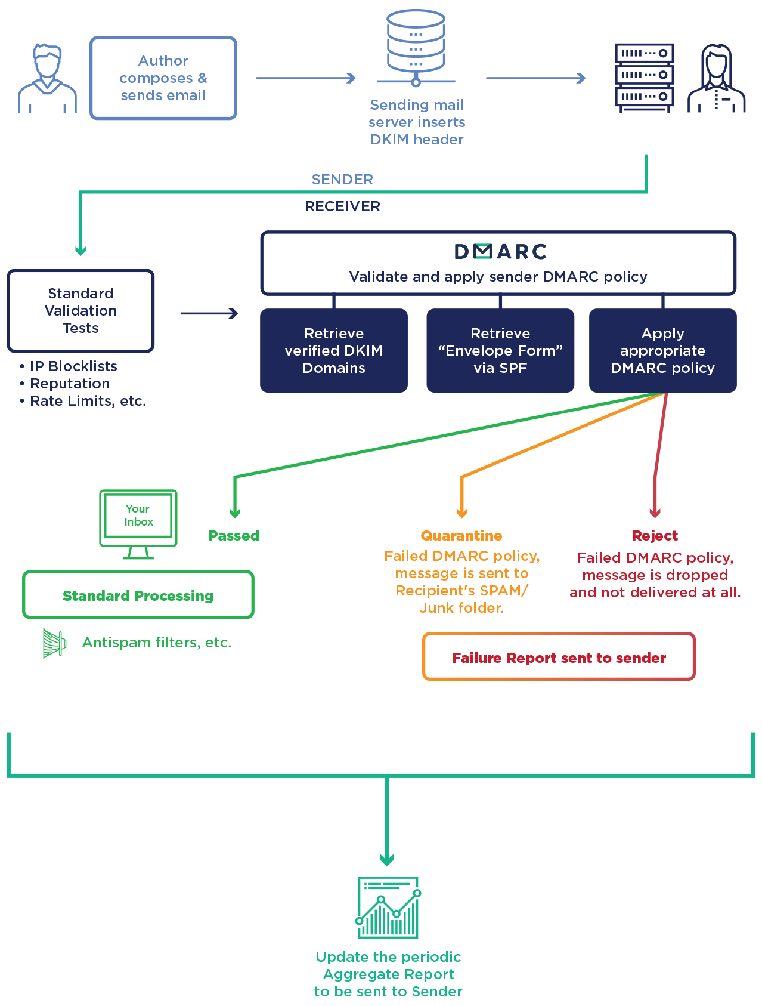

Slide 14
Office 365
Composite Authentication (compauth) – aka Machine Learning
ATP and EOP Anti-Spoof Protection. Microsoft using the power of the cloud to determine if spoofed email
Default AntiPhish Policy
Additional Policies
How To Configure
In the Office 365 Security and Compliance Centre
Via PowerShell

Slide 15






Phishing protection end-to-end
Internet edge block
Multi-Factor Authentication
Machine Learning
Sender authentication checks
Anti-phish mail flow protection
Implicit intra org domain spoof detection
ATP implicit external domain spoof detection
ATP user impersonation detection
FnR
Password reset
Search & purge
ATP domain impersonation detection
AV engine scan
URL reputation scan
Endpoint Security
ATP machine learning models
ATP block of attachments with bad URLs
SOC/IR
ATP attachment and link detonation for phishing
Zero hour auto purge (ZAP)
Post delivery
ATP Safelink Time of Click Protection
Protect the admins
Safe link for internal mail
//intranet
Outlook Report Message button
Safe link for Office clients
Last line
User awareness
Junk
Quarantine
Inbox
Inbox
Focused | Other

Slide 16

SPF, DKIM, DMARC
Anti-Phishing Policy Demo
New Insights and Reports
Report Message add-in
Transport Rules

Slide 17
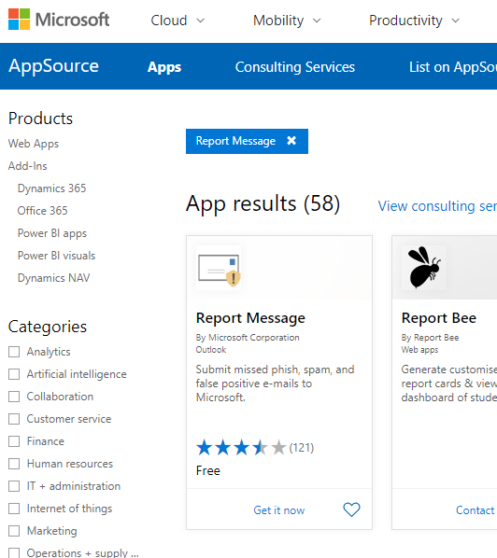
This all sounds hard - how to get started
SPF, DKIM
DMARC
Office 365
Anti-Spoof
Anti-Phishing
Report Add-in
Transport Rules

Slide 18
DMARC Phases
Monitor
Quarantine
Reject
Evaluate
Evaluate
Evaluate

Slide 19
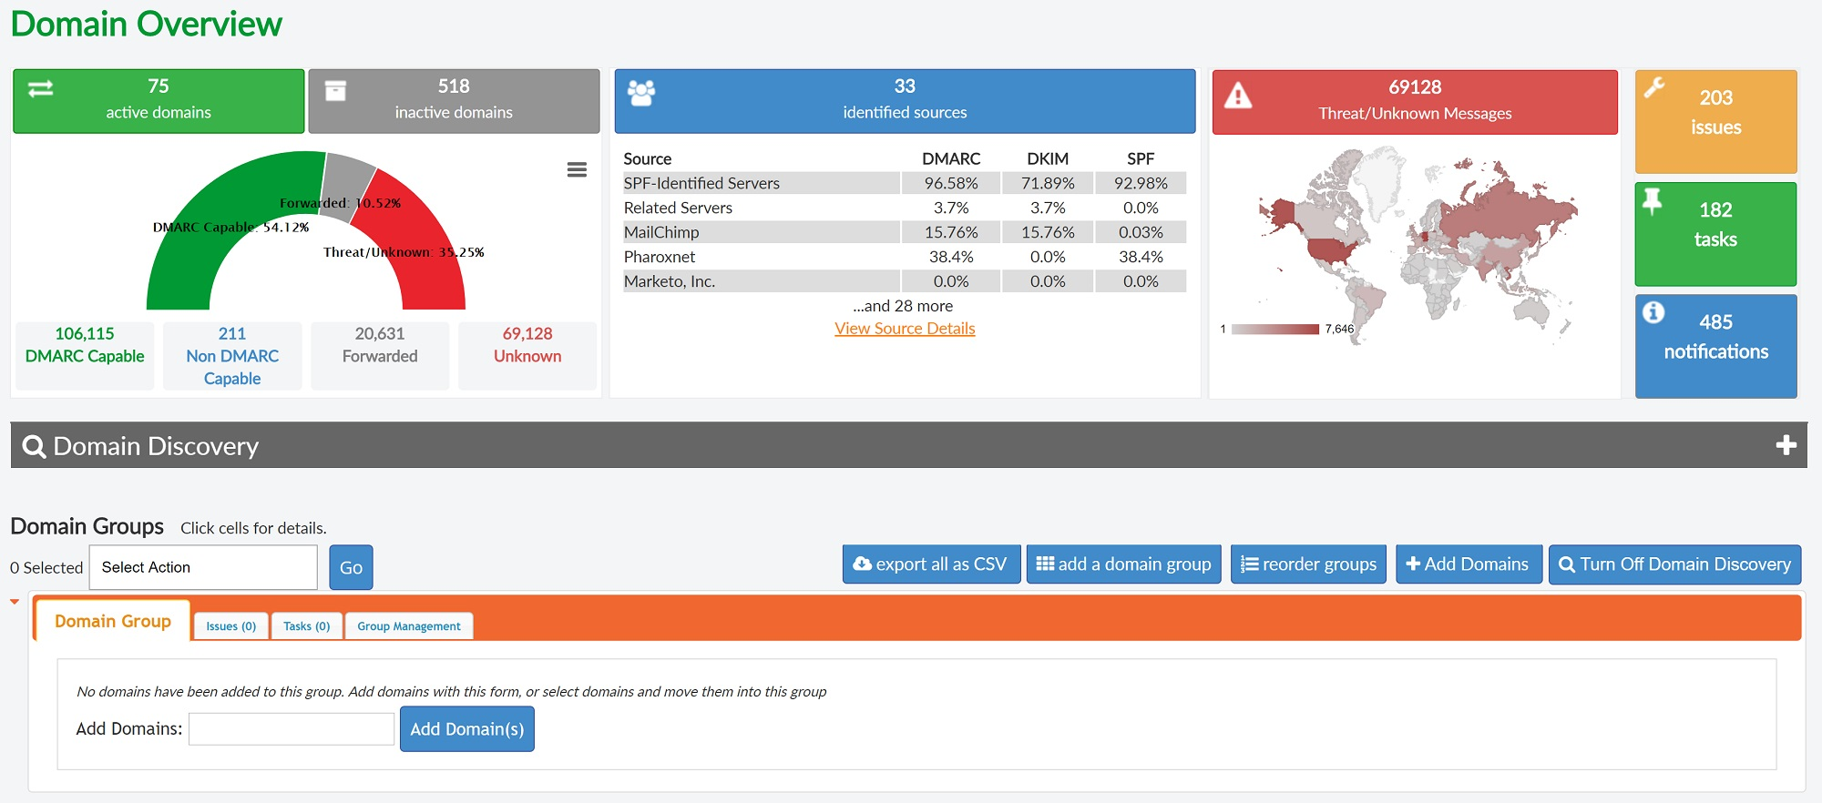
DMARC Report

Slide 20
DMARC Analysers
PostMarkApp https://dmarc.postmarkapp.com
DMARC Harvest Report (TechNet Gallery): https://gallery.technet.microsoft.com/Harvest-DMARC-items-for-9c0d911a)
DmarcAnalyzer: www.dmarcanalyzer.com
MXToolbox - https://mxtoolbox.com/dmarcsetup
Dmarcian – www.dmarcian.com

Slide 21
User Awareness
Simulations
Construct mails that match the level of sophistication that is trending in the wild.
Data is your best friend. Use exercise results to determine your next move.
Might as well test “the system” while you’re at it!
Training
Leverage large scale training programs for in-depth education.
Phishing isn’t just an email thing - include guidance on attack vectors such as “Smishing” and “Vishing”.
Keep the conversation going through ongoing awareness campaigns.
Reporting
What’s your 911? Make sure your community knows when and how to report.
Make reporting as quick and easy as possible.
Use reporting trends to inform program needs.
https://phishingquiz.withgoogle.com/

Slide 22
Best Practices
Architectural design of your mail flow and domains
Use both SPF and DKIM
Use DMARC authorization record
Common mistakes:
DMARC needs SPF and DKIM to succeed
Followup on DMARC Reports and Reports in Office 365

Slide 23
What are the other options to protect my users ?
Other ATP features
Office ATP for Safe Links and Safe Attachments
Insider Phishing
Attack Simulator
Multi-Factor Authentication
Conditional Access
Stopping Weak Password, Legacy Auth etc.
Authenticators and Hardware Tokens
E-mail Encryption (TLS) and Office 365 Message Encryption

Slide 24
Summary
SPF
DKIM
DMARC
Office 365 ATP
User Adoption & Awareness Campaigns

Slide 25

Thank You!
Do you have any Questions ?
Peter Schmidt
Mail: peter@neoconsulting.dk
Twitter: @petsch
Blog: www.msdigest.net
https://github.com/nordicinfrastructureconference/2019
Remember session evaluation – Thanks !
Dette billede efter Ukendt forfatter er licenseret under CC BY-NC-ND

